Slide 1
Choices
Galatians 5

Slide 2
Christ Has Set Us Free
5 For freedom Christ has set us free; stand firm therefore, and do not submit again to a yoke of slavery.
2 Look: I, Paul, say to you that if you accept circumcision, Christ will be of no advantage to you. 3 I testify again to every man who accepts circumcision that he is obligated to keep the whole law. 4 You are severed from Christ, you who would be justified[a] by the law; you have fallen away from grace. 5 For through the Spirit, by faith, we ourselves eagerly wait for the hope of righteousness. 6 For in Christ Jesus neither circumcision nor uncircumcision counts for anything, but only faith working through love.

Slide 3
⁷ You were running well. Who hindered you from obeying the truth? ⁸ This persuasion is not from him who calls you. ⁹ A little leaven leavens the whole lump. ¹⁰ I have confidence in the Lord that you will take no other view than mine, and the one who is troubling you will bear the penalty, whoever he is. ¹¹ But if I, brothers,^{[b]} still preach^{[c]} circumcision, why am I still being persecuted? In that case the offence of the cross has been removed. ¹² I wish those who unsettle you would emasculate themselves!

Slide 4
¹³ For you were called to freedom, brothers. Only do not use your freedom as an opportunity for the flesh, but through love serve one another. ¹⁴ For the whole law is fulfilled in one word: “You shall love your neighbour as yourself.” ¹⁵ But if you bite and devour one another, watch out that you are not consumed by one another.
Walk by the Spirit
¹⁶ But I say, walk by the Spirit, and you will not gratify the desires of the flesh. ¹⁷ For the desires of the flesh are against the Spirit, and the desires of the Spirit are against the flesh, for these are opposed to each other, to keep you from doing the things you want to do. ¹⁸ But if you are led by the Spirit, you are not under the law.

Slide 5
¹⁹ Now the works of the flesh are evident: sexual immorality, impurity, sensuality, ²⁰ idolatry, sorcery, enmity, strife, jealousy, fits of anger, rivalries, dissensions, divisions, ²¹ envy,^{[d]} drunkenness, orgies, and things like these. I warn you, as I warned you before, that those who do such things will not inherit the kingdom of God. ²² But the fruit of the Spirit is love, joy, peace, patience, kindness, goodness, faithfulness, ²³ gentleness, self-control; against such things there is no law. ²⁴ And those who belong to Christ Jesus have crucified the flesh with its passions and desires.
²⁵ If we live by the Spirit, let us also walk by the Spirit. ²⁶ Let us not become conceited, provoking one another, envying one another.

Slide 6
Freedom!
Children of God
Heavenly home
Eternal life
Relationship with the Father

Slide 7
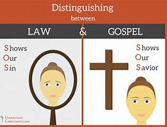
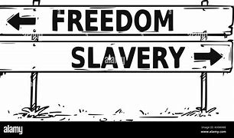
Christ vs Law
Freedom vs Slavery
Flesh vs Spirit

Slide 8
Christ vs Law

Slide 9
Romans 3 v 20
20 For by works of the law no human being[c] will be justified in his sight, since through the law comes knowledge of sin.

Slide 10
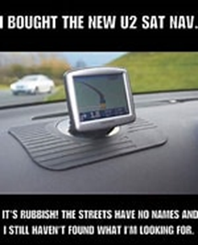

Slide 11
Freedom vs Slavery

Slide 12
Galatians 3 v 23 - 25
²³ Now before faith came, we were held captive under the law, imprisoned until the coming faith would be revealed. ²⁴ So then, the law was our guardian until Christ came, in order that we might be justified by faith. ²⁵ But now that faith has come, we are no longer under a guardian

Slide 14
Flesh vs Spirit

Slide 15
Romans 6 v 12 - 14
¹² Let not sin therefore reign in your mortal body, to make you obey its passions. ¹³ Do not present your members to sin as instruments for unrighteousness, but present yourselves to God as those who have been brought from death to life, and your members to God as instruments for righteousness. ¹⁴ For sin will have no dominion over you, since you are not under law but under grace.

Slide 17
Daily prayer –
Holy Spirit I give you today. May I do everything you lead me to do and nothing my flesh wants me to do that is harmful either to me or to others. Lead me and guide me in all I do and if I’m going to do wrong wake me up to hear you saying ‘this is the way, walk in it’.

Slide 18
Matthew 11 v 28 - 29
²⁸ Come to me, all who labour and are heavy laden, and I will give you rest. ²⁹ Take my yoke upon you, and learn from me, for I am gentle and lowly in heart, and you will find rest for your souls. ³⁰ For my yoke is easy, and my burden is light.”

Slide 19
Christ vs Law

Slide 20
Freedom vs Slavery

Slide 21
Flesh vs Spirit

